Slide 1
Project 2
Urban Transportation
Network Analysis
Tianyi Wang & Che Dong & Liangyu Shao & Yixiao Wang
04/07/2025
Efrei & BIPT
Instructor: Lilia SFAXI

Slide 2
CONTENTS
01
02
03
04
05
Description of project
The Overall Design
Implementation
Project results
Summary

Slide 3
Part
One
Description of project

Slide 4
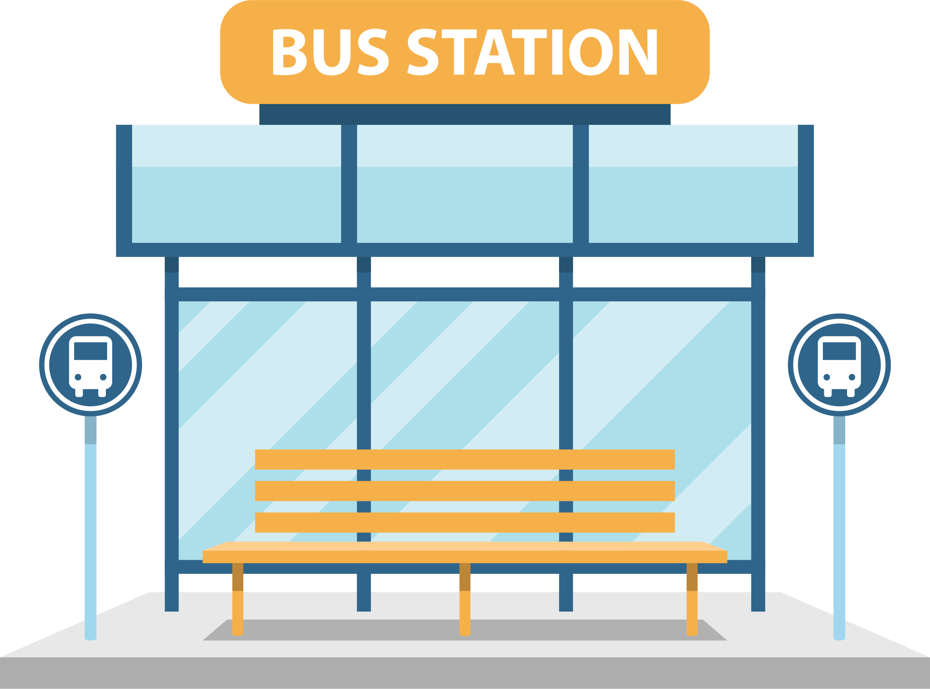
Urban Bus Network Analysis System
Smart Transit Decision-Making Tool
Core Purpose
Optimize urban transit via dynamic analysis, efficiency metrics & congestion-aware planning.
Approach
​​Graph Theory Modeling & Algorithm Data Structure
Nodes = Bus Stops
Directed Edges = Bus Routes

Slide 5
Key Requirements
Dynamic
Network
Modeling
Smart Zoning & Simulation
Divide the type of zone: 🏠 Residential | 🏢 Commercial 🏭 Industrial | 🔀 Mixed
Peak-hour traffic impact simulation
Add/remove/edit stops & routes
Real-time graph adaptation
Path & Efficiency Analysis
Shortest path (Dijkstra) + The most efficient paths (DFS)
​​Efficiency = Distance / Time
Shortest Path
≠
Most Efficient Path
Core validation

Slide 6
Part
Two
The Overall Design

Slide 7
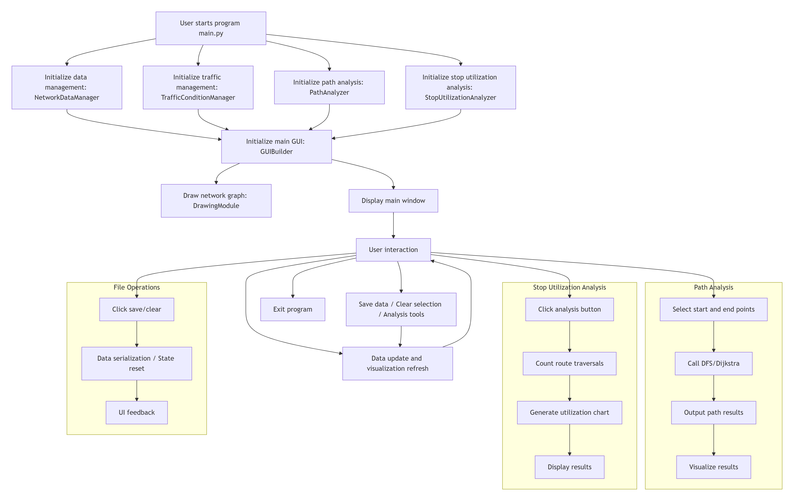
The system is divided into four major modules:
​​Data Structure Module​​
​​Data Processing Module​​
​​Algorithm Module​​
​​Frontend Interface and Visualization Module​​
System Workflow Diagram

Slide 8

​​Why Use Dijkstra
Algorithm?​
Finds ​​single-source shortest paths​​ in weighted graphs (e.g., bus/traffic networks).
→ ​​Guaranteed Optimality
→ ​​Controlled Efficiency
→ Domain Alignment
→ Predictability
​​Why Use DFS
Algorithm?​
Exhaustive ​​path traversal​​ and ​​enumeration​​ in graphs (e.g., exploring all possible routes in transportation networks).
→ ​​Complete Path Discovery​
→ ​​Complex Network Navigation​
→ ​​Implementation Flexibility

Slide 9
​​Why Stack over Recursion in DFS?​​
→ Explicit stack management ​​prevents stack overflow​​ during deep graph traversal.
→ ​​Avoids function call overhead.
→ ​​Direct access to traversal state​​ (e.g., early termination via loop conditions).
→ Simplifies ​​custom pruning logic​​ (e.g., depth limits or cost thresholds).
→ Stack state (​​current path/depth​​) is ​​explicitly visible​​ during debugging.
​​Why Min-Heap in Dijkstra?​
→ ​​Guarantees​​ extracting the node with smallest current distance
→ ​​O(log n)​​ for both Insert (decrease-key) and Extract-Min operations
→ Beats sorted arrays (O(n) inserts) and unordered lists (O(n) min-search)

Slide 10
Part
Three
Implementation

Slide 11
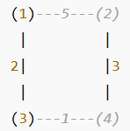
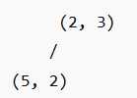
Dijkstra Algorithm
Dijkstra Algorithm: Min-Heap Optimized Shortest Path
①
②
Suppose the bus network is as follows
Stop 1→4
Update neighbors
1 → 2: Distance = 0 + 5 = 5
1 → 3: Distance = 0 + 2 = 2
The initial structure is as follows：
The content of the heap：(0, 1)
distance
stop_ID

Slide 12
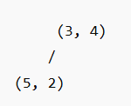
Dijkstra Algorithm
Dijkstra Algorithm: Min-Heap Optimized Shortest Path
Min-Heap——The value of the parent node is less than that of the child nodes
③
Pop(2,3)
④
Pop(3,4)
Arrived at the terminal station! The path ends.
distance
stop_ID
Update neighbors
3 → 4: Distance = 2 + 1 = 3

Slide 13
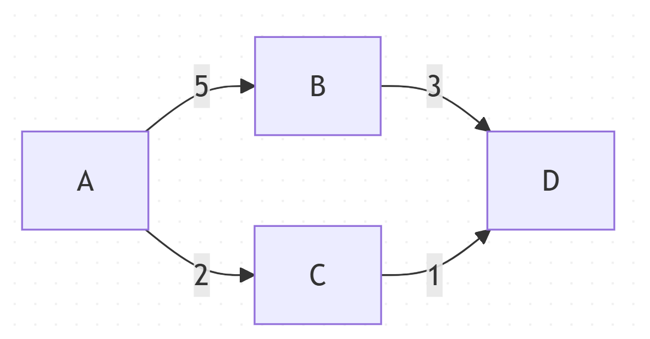
DFS Algorithm
Represent the network using an adjacency list, explore all paths with a stack, and only retain the paths that do not exceed the maximum distance.
①
Adjacency list
{
1: [(2, 5), (3, 2)],
2: [(4, 3)],
3: [(4, 1)],
4: []
}
Indicate:
Stop1 → Stop2 (distance:5)
For example:
Find all the paths from 1 to 4, with a maximum distance of 80 kilometers
Initialization stack:
stack = [(1, [1], 0)]
current_ID
current_path_list
current_total_distance

Slide 14
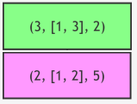
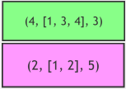
DFS Algorithm
Stack——Last in, first out
②
③
Pop(1, [1], 0) The neighbors are: B , C
push (2, [1, 2], 5)
push (3, [1, 3], 2)
Pop (3, [1, 3], 2)
The neighbor is: D
√ The total distance = 2 + 1 = 3 < 80
push (4, [1, 3, 4], 3)

Slide 15
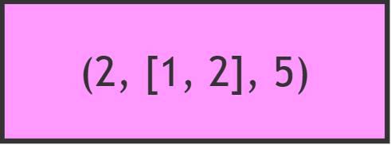
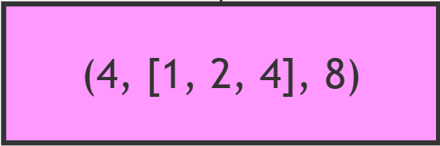
DFS Algorithm
Stack——Last in, first out
④
⑤
Pop (2, [1, 2], 5)
The neighbor is: D
√ The total distance = 5 + 3 = 8 < 80
push (4, [1, 2, 4], 8)
Pop(4, [1, 3, 4], 3)
It's the destination. Record this path
all_paths = [([1, 3, 4], 3)]

Slide 16

DFS Algorithm
Stack——Last in, first out
⑥
⑦
✅ Final result
Pop (4, [1, 2, 4], 8)
It's the destination. Record this path
all_paths = [([1, 3, 4], 3), ([1, 2, 4], 8)]
ALL Path | Distance
1 → 3 → 4 | 3
1 → 2 → 4 | 8

Slide 17
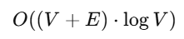
Analysis of Time Complexity & Space Complexity
Dijkstra Algorithm: Min-Heap
DFS Algorithm: Stack + adjacency list
Operation | Complexity | Frequency
Pop the heap top | O(log V) | V times
Update neighbors | O(log V) | At most E times
Time Complexity：
O(V·E)
Space Complexity：
O(V·E)
Time Complexity：
Space Complexity：
O(V)
V: Number of stops E: Number of connections

Slide 18
Part
Four
Project results

Slide 19
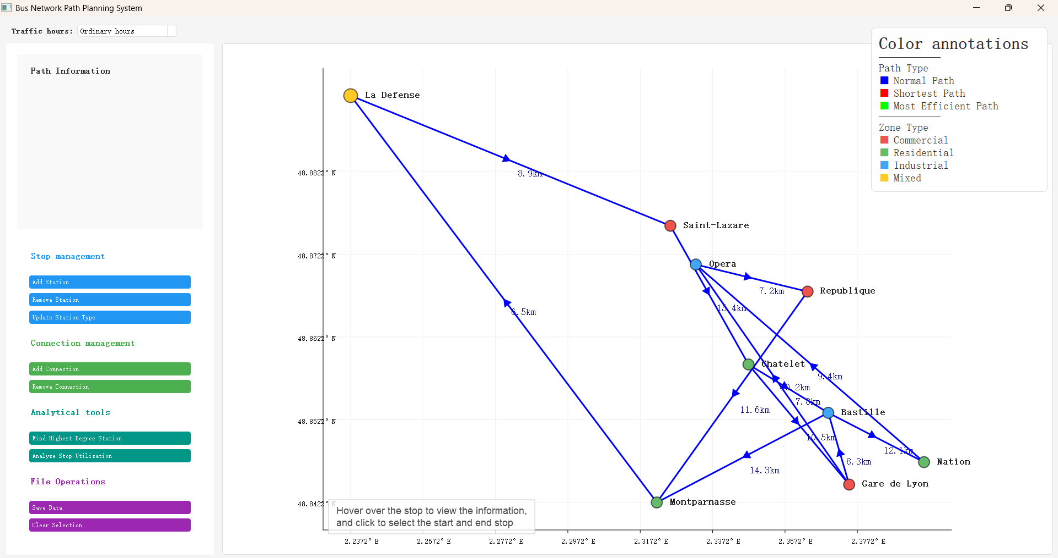
Main Interface
Main interface
Information on the recommended route
Stop management
Connection management
Analytical tools
File Operations

Slide 20
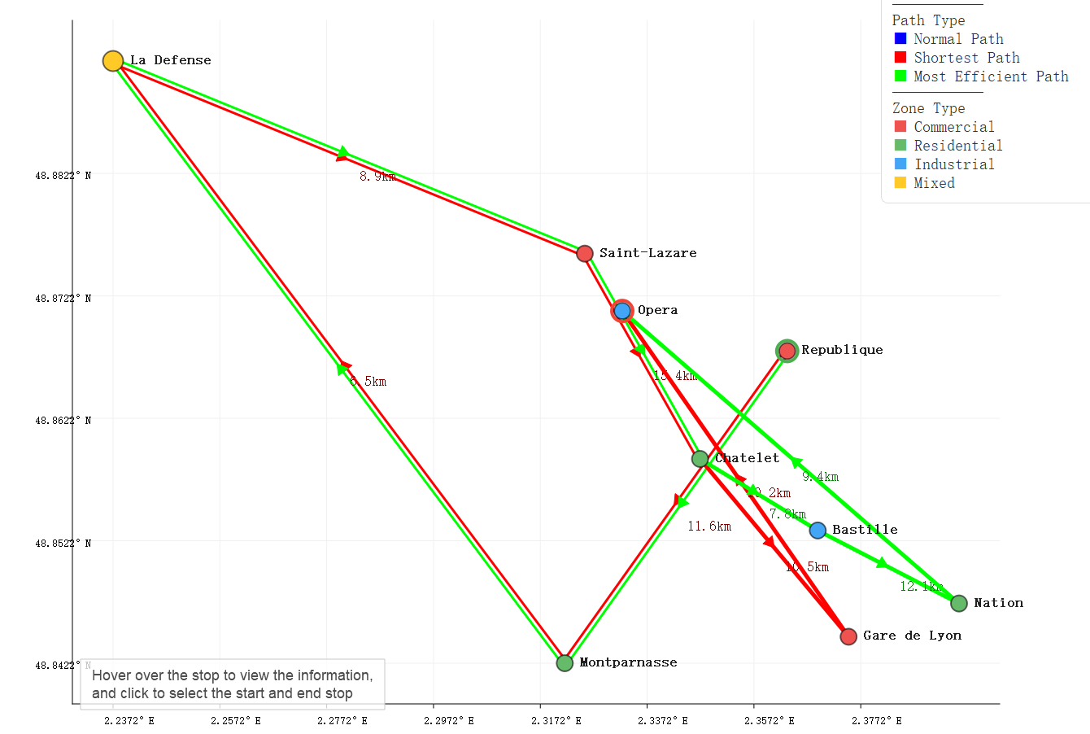
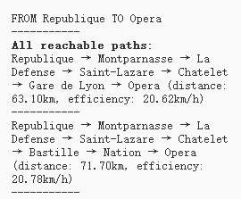
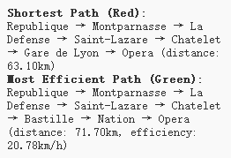
Route Recommendation
① Click Republique as the starting point and Opera as the ending point
② The system will respectively provide the shortest route, the most efficient route, and all routes (<80km)

Slide 21
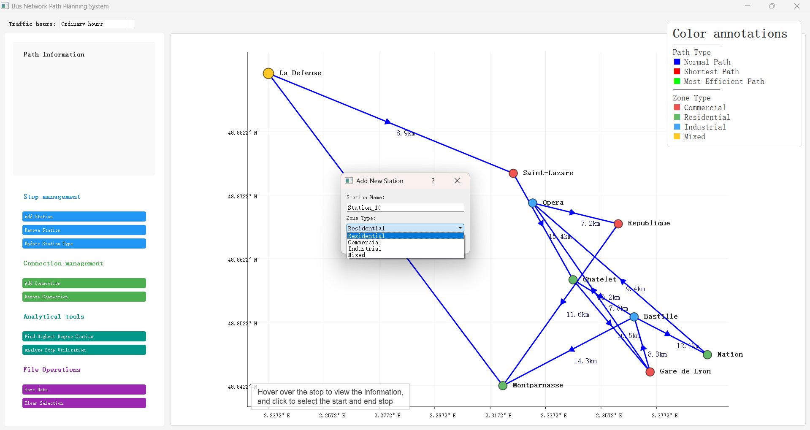
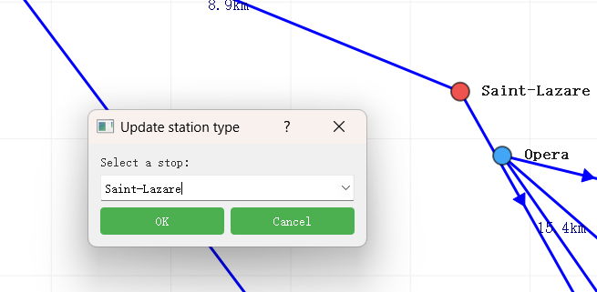
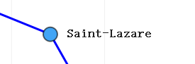
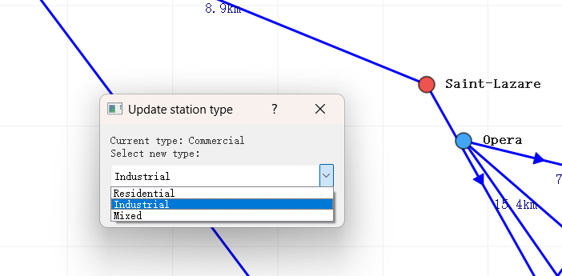
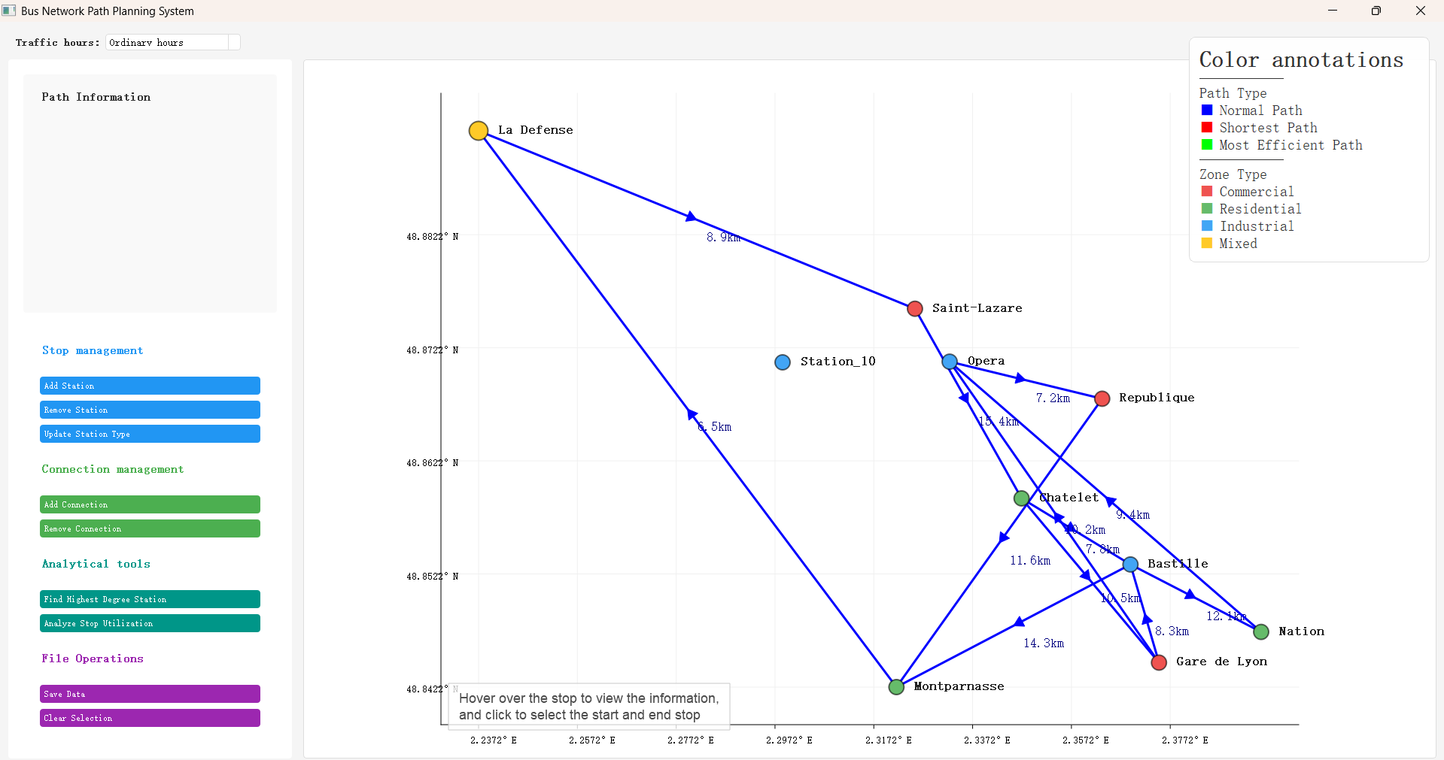
Stop management
① Click to select the location for adding the stop
② Click on a certain stop can delete that stop
③ The stop can be updated to different types
Stop_10 was created
Saint-Lazare has changed from commercial to industrial

Slide 22
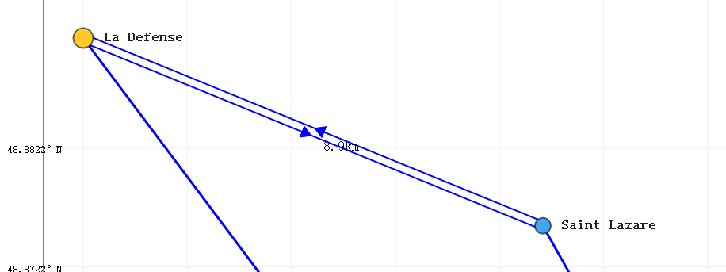
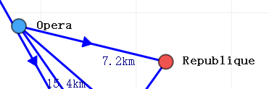
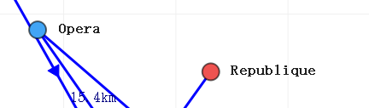
Connection management
① Click on the start and end stop to add a connection(bidirectional connection supported)
② Click on the start and end points to delete the connection
bidirectional connection was created
a connection was removed

Slide 23
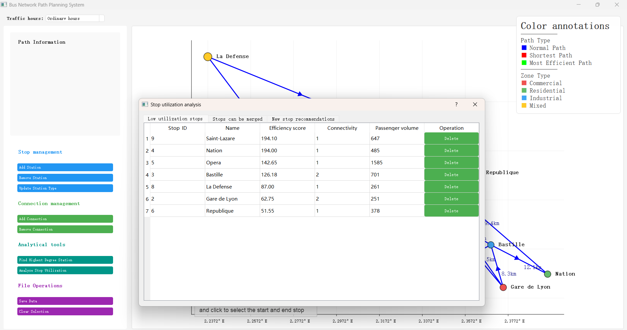
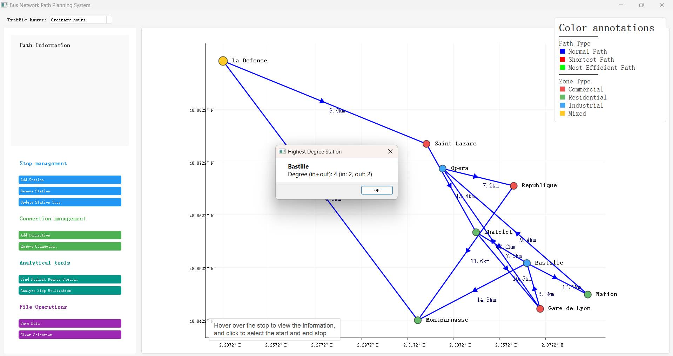
Analytical tools
① The point with the highest centrality can be sought
② The utilization rate of the site can be analyzed
Bastille is the highest degree stop
Stops with low utilization rates can be deleted

Slide 24
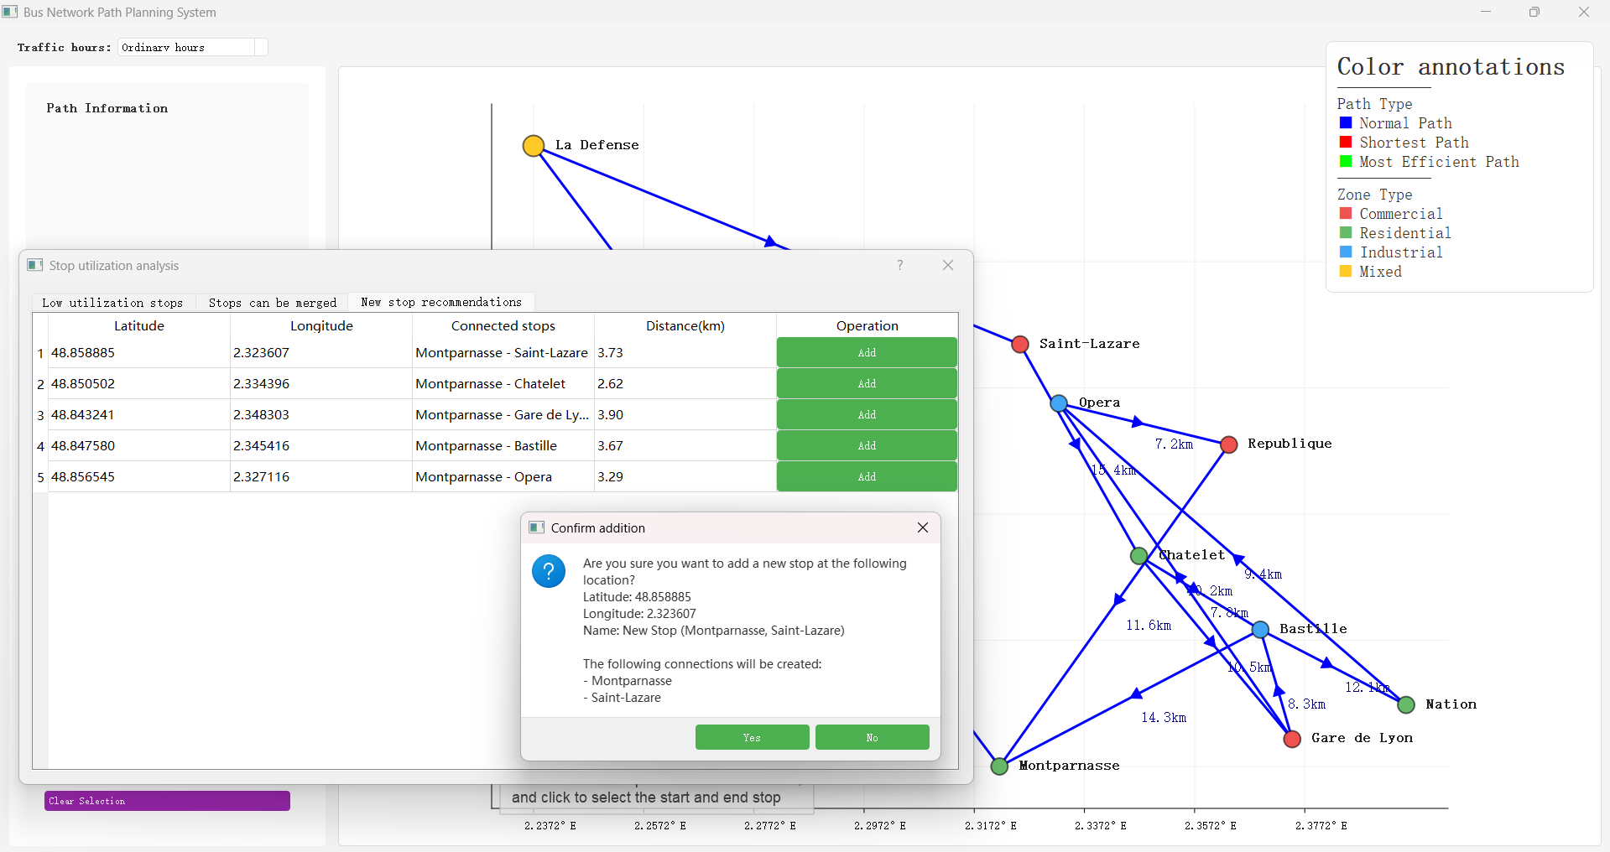
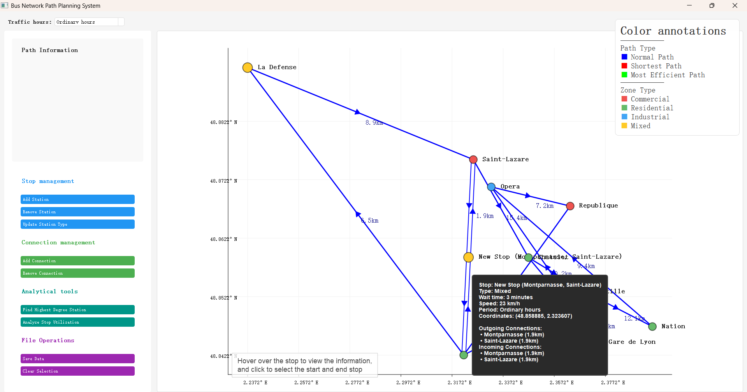
Analytical tools
② The utilization rate of the site can be analyzed
Recommend new stops based on distance and utilization rate

Slide 25
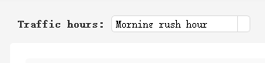
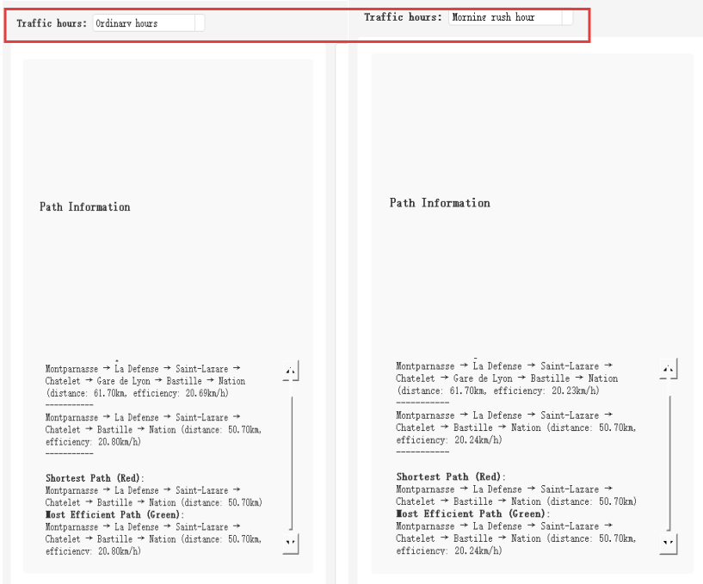
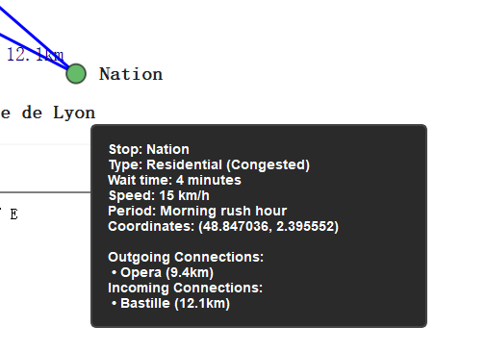
Peak hour selection
①Change different traffic hours: morning rush hour, evening rush hour, and regular hours
The extension of different types of waiting times
The reduction of path efficiency

Slide 26
Part
Five
Summary

Slide 27
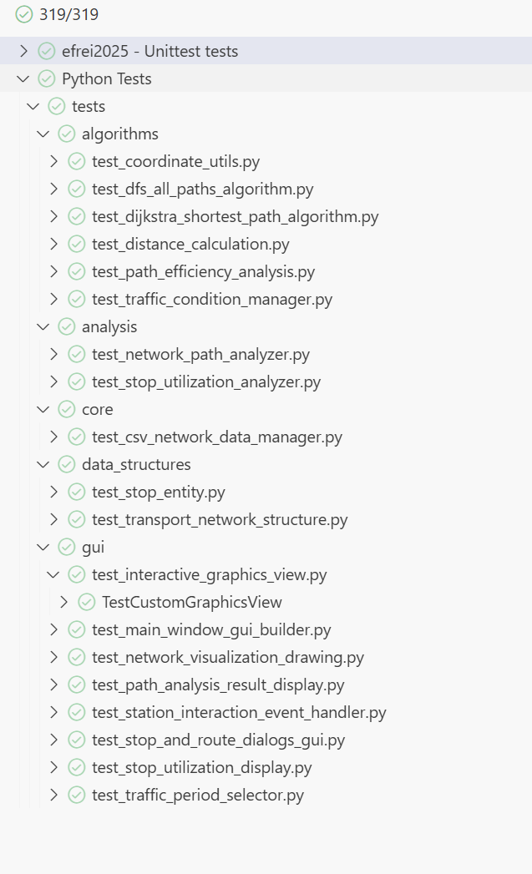
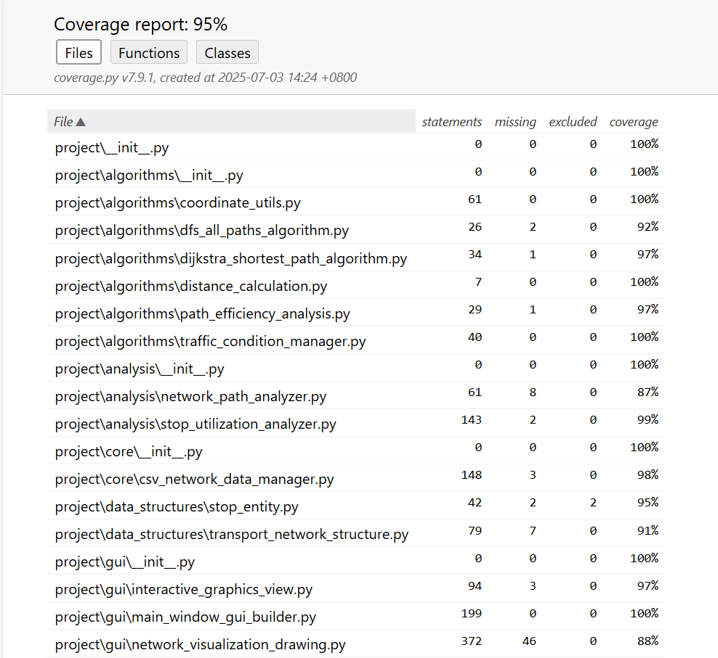
Unit test

Slide 28

Division of the project
Tianyi Wang
Che Dong
​​Algorithm & System Lead
→ Designed core ​​data structures & algorithms​​
→ Developed codebase​​ (algorithms, unit tests, frontend, main program)
→ ​​Task delegation
→ R​eport/presentation​
​​Frontend & Testing Specialist
→ Implemented ​​GUI interface & interactive features​​
→ Executed ​​code coverage testing​​ (unit/integration tests)
→ Co-designed algorithms and ​​report/presentation​
Liangyu Shao
Yixiao Wang
​​Validation & Documentation
→ Performed ​​algorithm verification​​ (manual test cases)
→ Authored ​​report sections & presentation content​
🙂 Prepare for presentation

Slide 29

Summary of the experiment
Graph Theory in Practice​
Development Challenges​​
​​Algorithms Validated​​: Dijkstra (shortest path) + DFS (path exploration) scale in complex networks
→ ​​Data Structure Design​​: Optimized for algorithmic efficiency
→ ​​User Flow Optimization​​: Seamless interaction via modular architecture
Technical Breakthroughs​​
Future Roadmap​​
→ ​​Geo-spatial Processing​​:
Longitude/Latitude ↔ Pixel coordinate conversion
→ ​​Stack (LIFO), Graph, and List implementations
→ Real-time traffic data integration
→ Paris transit optimization applications

Slide 30
Project 2
Urban Transportation
Network Analysis
Merci pour le tutoriel
04/07/2025
Efrei & BIPT

